Slide 1
Data Transformation in Fabric
Henri Schulte
Christian Ømand
Partner Solution Architect, Microsoft DK

Slide 2
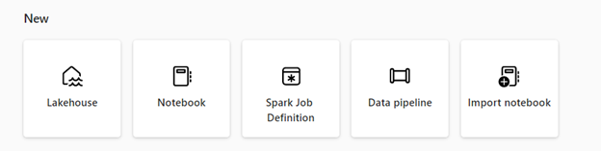
Data Engineering in Microsoft Fabric
Notebook
Notebooks are an interactive computing environment that allows users to create and share documents that contain live code, equations, visualizations, and narrative text. They allow users to write and execute code in various programming languages, including Python, R, and Scala and are used for data ingestion, preparation, analysis, and other data-related tasks.
Data pipeline
Data pipelines are a series of steps that are used to collect, process, and transform data from its raw form to a format that can be used for analysis and decision-making. They're a critical component of data engineering, as they provide a way to move data from its source to its destination in a reliable, scalable, and efficient way.
Apache Spark job definition
Spark job definitions are set of instructions that define how to execute a job on a Spark cluster. It includes information such as the input and output data sources, the transformations, and the configuration settings for the Spark application. Spark job Definition allows you to submit batch/streaming job to Spark cluster, apply different transformation logic to the data hosted on your Lakehouse along with many other things.
What is Data engineering in Microsoft Fabric? - Microsoft Fabric | Microsoft Learn

Slide 3
Section title one
Notebooks

Slide 4

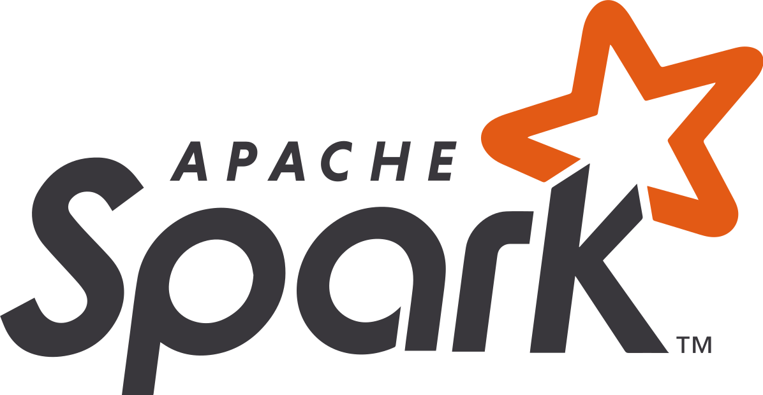
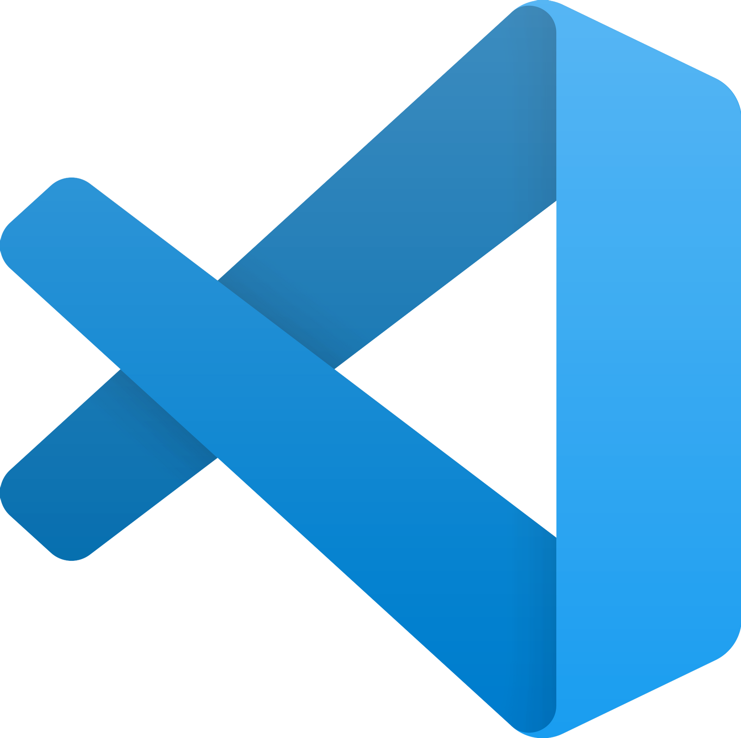
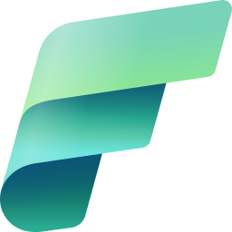
Data engineering in Fabric Empower data engineers to transform data at scale and build a lakehouse architecture
New Slide (01:40)
Build a lakehouse for all your organizational data
Spark runtime with great out of the box performance and robust admin controls
Delightful authoring experience in your tools of choice
Completely integrated into the Fabric foundation

Slide 5
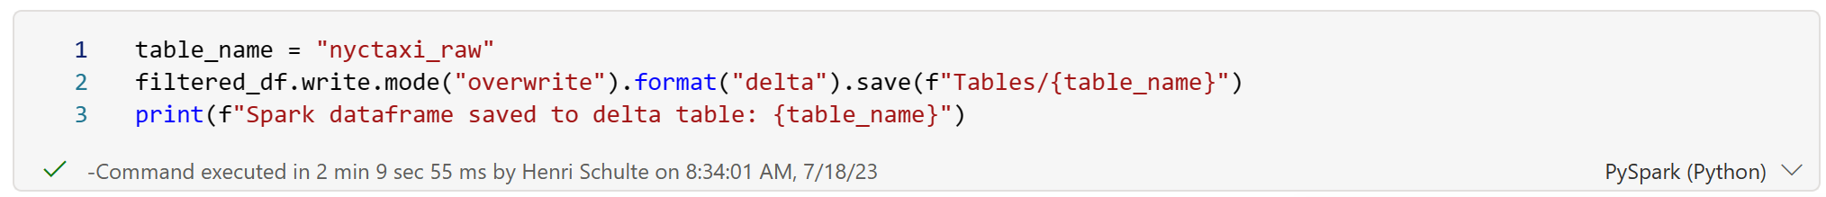
Familiar Spark notebook experience
Use your language of choice. Choose between
PySpark (Python)
Spark (Scala)
Spark SQL
SparkR (R)
Add comments, visuals, interactive elements alongside your code.
Used for both data engineering and data science (more on that later).

Slide 6


Start up times
New Slide (09:36)
Public preview
Get started with running Spark in a matter of seconds
Starter pools come pre-wired to Fabric workspaces meaning users can get started running Spark with no cluster setup necessary
Starter pools are kept ‘live’, meaning they provide Spark sessions within 10-15 seconds
High concurrency mode enables users to share Spark sessions across multiple notebooks
Attaching a notebook to an existing session results in lightning-fast session start up speed <5 seconds
Just announced:
High concurrency mode support will be available for notebooks in pipelines

Slide 7
Section title two
Dataflows Gen 2

Slide 8








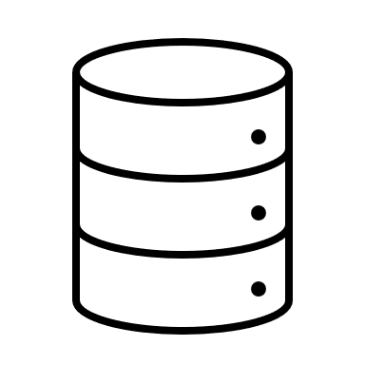


Dataflows Gen2
Read from a dataflow
Staged in the Fabric warehouse
Datasets
Reports
Dashboards
Workspace A / Bronze
Workspace B / Silver
Dataflows are a self-service, cloud-based, data preparation technology.
Dataflows are available in Power BI, Power Apps and Dynamics 365 Customer Insights.
Workspace C / Gold
Write to a destination
Lakehouses
Datasets
Reports
Workspace
Notes:
`Dataflows are a type of cloud-based ETL (Extract, Transform, Load) tool for building and executing scalable data transformation processes.
Dataflows (Gen2) allow you to extract data from various sources, transform it using a wide range of transformation operations, and load it into a destination. Using Power Query Online also allows for a visual interface to perform these tasks.
Fundamentally, a dataflow includes all of the transformations to reduce data prep time and then can be loaded into a new table, included in a Data Pipeline, or used as a data source by data analysts.

Slide 9
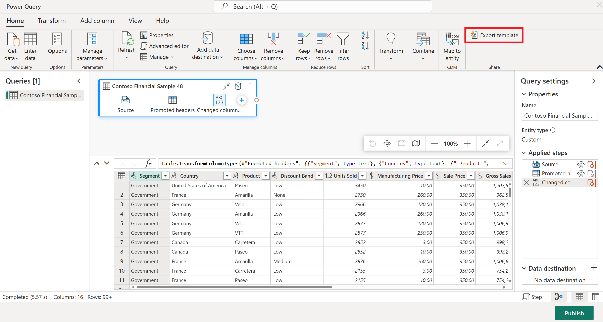
Dataflows Gen2
Dataflow Gen2 provides a low-code/no-code experience to build transformation workflows, opening up the platform to more users. It is reminiscent of excel.
Makes it possible for business users to look at data quality and perform cleaning operations, providing more downstream capabilities.
It offers a way of performing data ingestion from many sources (150+ connectors) into the platform using the wide variety of connectors that exist in the power platform.
It works well for small and medium data volumes, but not for ‘big data’ volumes. Think ‘millions of rows’, not ‘billions of rows’ when you think dataflows
Power Query uses the ‘M’ language
Notes:
`

Slide 10
Feature | Dataflow Gen2 | Dataflow Gen1
Author dataflows with Power Query | ✓ | ✓
Shorter authoring flow | ✓
Auto-Save and background publishing | ✓
Data destinations | ✓
Improved monitoring and refresh history | ✓
Integration with data pipelines | ✓
High-scale compute | ✓
Get Data via Dataflows connector | ✓ | ✓
Direct Query via Dataflows connector |  | ✓
Incremental refresh |  | ✓
AI Insights support |  | ✓

Slide 11
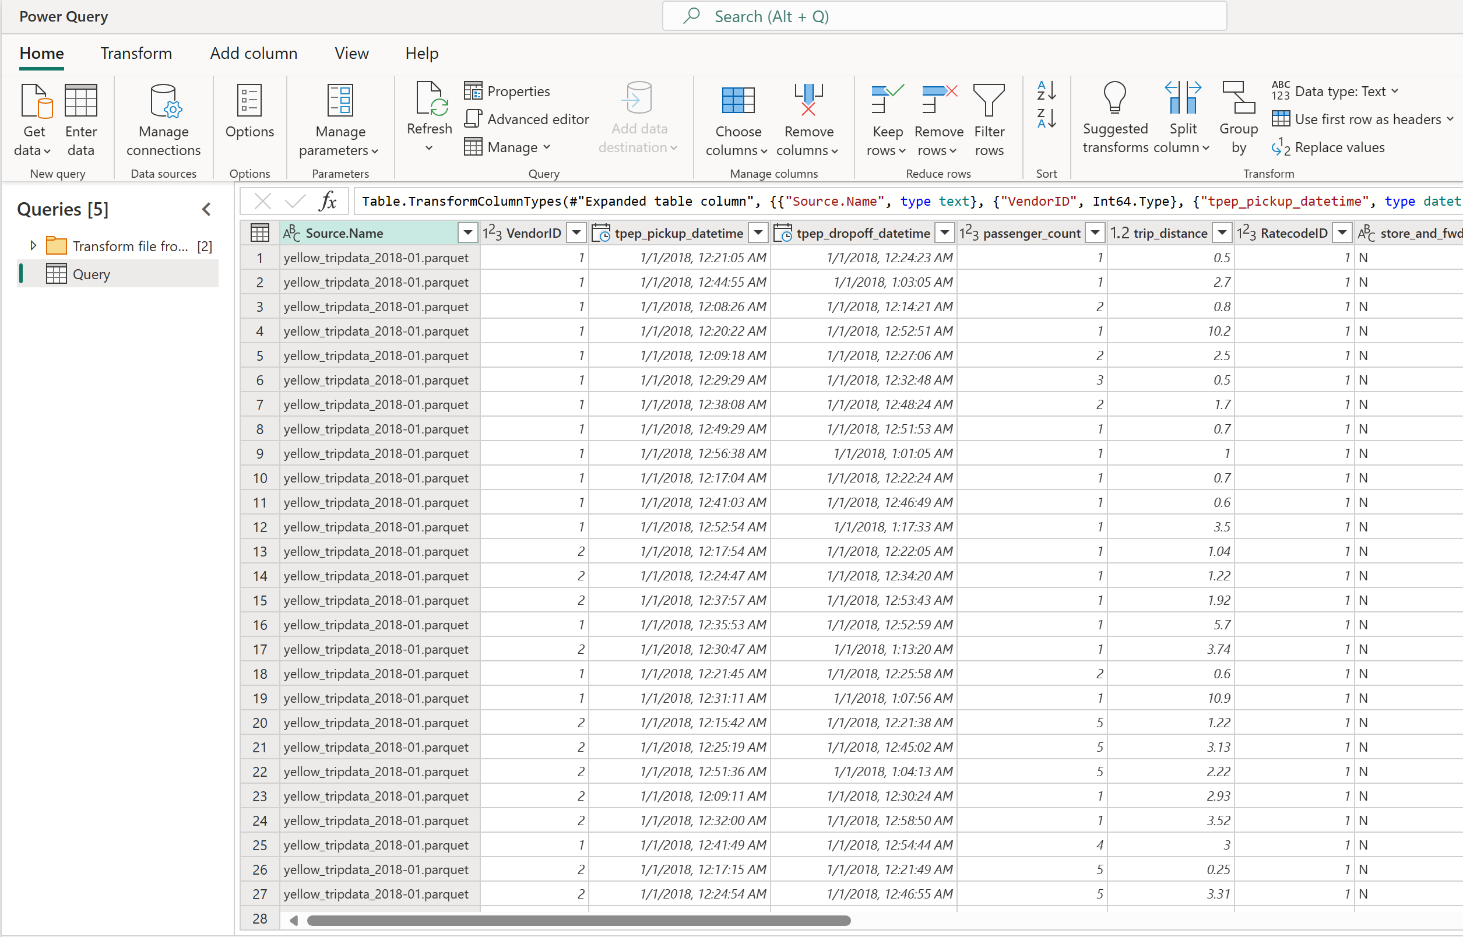
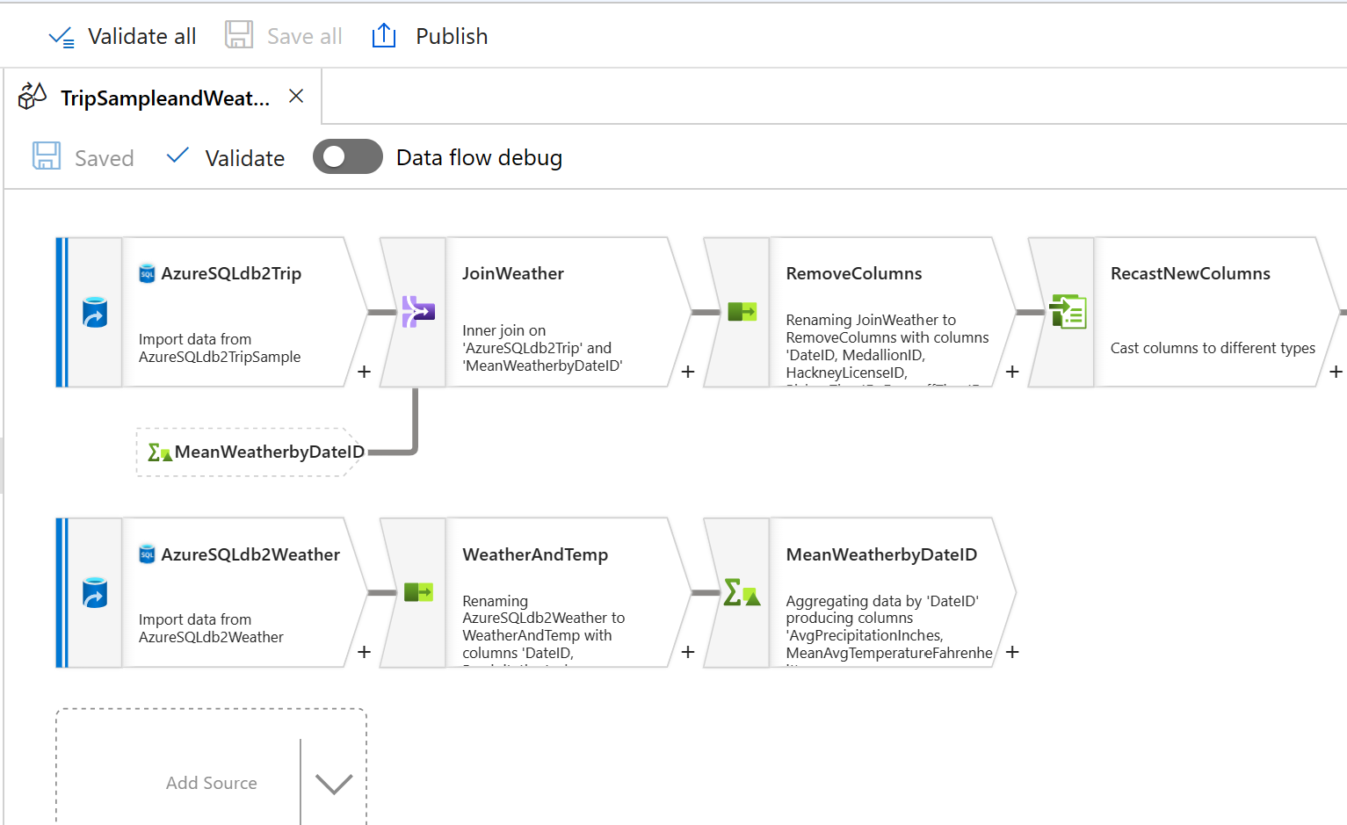
Dataflows Gen2 ≠ Mapping Dataflows (Synapse Dataflows)
Dataflows Gen2 (Power Query)
Mapping dataflows
Notes:
`

Slide 12
Copy Activity vs Dataflow vs Spark
 | Pipeline Copy Activity | Dataflow Gen 2 | Spark Notebook Job Definition
Use case | Data lake and data warehouse migration, data ingestion Light weight transformation | Data transformation, data wrangling, data profiling Data ingestion | Data transformation, data processing, data profiling, data profiling Data ingestion
Primary developer persona | Data engineer, data integrator | Data engineer, data integrator, business analyst | Data engineer data scientist, data developer
Primary developer skillset | ETL, SQL, JSON | ETL, M, SQL | Spark (Scala, PySpark, Spark SQL, R)
Code written | No code Low code | No code Low code | Code
Data volume | Low to High | Low to High | High
Development interface | Wizard Canvas | Power Query | Notebook Spark job definition
Sources | 30+ connectors | 150+ connectors | Hundreds of Spark libraries
Destinations | 18+ connectors | Lakehouse Azure SQL database Azure Data explorer Azure Synapse analytics | Hundreds of Spark libraries
Transformation complexity | Low: Lightweight - type conversion, column mapping, merge/split files, flatten hierarchy | Low to high: 300+ transformation functions | Low to high: Support for native Spark and open-source libraries
Fabric decision guide - copy activity, dataflow, or Spark - Microsoft Fabric | Microsoft Learn

Slide 13
Thank you

